Slide 1


Solution By: Tech_Rakshan
PSID: INTL-DA-07
Team Leader Name: Praseeda Saripalle

Slide 2

Idea Introduction
Identification of Crime Prone Areas
Tech Stack
1. Python(Geopy,Scipy)
2. ML(Clustering algorithms and supervised leaning algorithms
3. Django,HTML,Sqlite
Resources Used
https://docs.google.com/document/d/1oDXvhnsFBCskgVU4i1S9jMD6_tAOu7lo4vpLAOkYREY/edit
Any Third Party API/Services used
Yes
Cop’s Crime Assist
Strategic Level:
Our solution provides segregation of incidents by crime, by location or by day using Machine learning clustering algorithms so that top management gets an Birdseye view and bring contain strategies.
Tactical:
Our solution assist Cop in terms of analyze and visualize crime incidents geographically (in a particular location using longitude and latitude).
This assist also helps for prediction of likelihood of incident on a particular day and time, so that cops can manage their resources accordingly to avert potential incident.

Slide 3
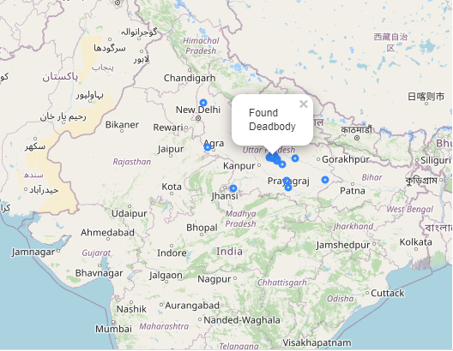
Your Approach Towards Idea
Approach:
Collect various crime datasets.
Apply Geocoding for missing latitude and longitude datasets(physical address to spatial representation)
EDA(data visualization,visualize the data on maps using Folium, zoom on the map for detailing, an additional heat map would improve the visibility of high-frequency areas where multiple indicators may overlap)
Clustering using Machine Learning techniques for cluster-specific incidents.
Usage of Time series data and Machine learning to predict locations of next incidences
How you Targeted problem?
There is a high availability of unstructured and structured crime data. However, data driven decision systems are evolving.
Hence our solution becomes more handy for Police Personnel.
What Innovation or feature you added
Geocoding(physical address to spatial address conversion)
Birdseye view using clustering for Super Cops.
Tactical view and prediction for a operational cop
Any functional requirement in further development ?
Crime Analysis using social media handles and smartphone tracking.
Notes:
Use any image of your proposed solution here instead of this macbook image

Slide 4

Team Slide
Mentor
Dr. M Bhanu Sridhar
Member1
Lasya.K
Member2
Meghana.Ch
Member3
Bhagyasree.S
Member4
Chaitra.R

Slide 5
Development Pipeline
Any Third party API used, if yes please specify
Heroku for Deployment
GPS live tracking
Documents To be prepared for installation and evaluation
Will be provided post project completion.
Repository Link or Any references link of folders
https://github.com/PraseedaSaripalle/Tech_Rakshan
Proposed Development Plan in pointers
1.Dataset Collection
2.Geocoding
3. EDA
4. Clustering
5.Prediction
Proposed UI and functional flow in pointers
1.Visualizations on UI using Django framework.
2.ReactJS
Step A
Step B
Step C
Step D
Step E

Slide 6
Vision of Innovation/Idea/Solution
Explain How you developed Idea
Increase in the rate of crime has generated public uproar which increased expectation on contemporary policing.
We seek to use impact of technological innovation on crime prevention and effective policing
How you idea is different and innovative form other ideas- a default comparison
Our solution predominantly focuses on to improve the performance of police using live geo-tracking and early stage prediction of potential incidents.
How much time it will take in conversion as a final product
We estimated 90 man hours for the prototype to be completion, which is around 2 weeks of time.
Any early stage innovation detected while developing the solution
Geocoding(physical address to spatial address conversion
Birdseye view using clustering for Super Cops.
Tactical view and prediction for a operational cop

